Slide 1
Opening a new shopping mall in delhi ,india
SubmiTted by:
Ritwick Bisht

Slide 2
Business problem
Objective : To analyse the neighbourhood of the state Delhi , India to find the best location for opening the shopping mall (in python).

Slide 3
Data collection
Data Requirement
Lists of neighbourhood
Latitude and longitude of each neighbourhood
Venues around 2.5km radius of each neighbourhood
Source
Wikipedia : https://en.wikipedia.org/wiki/Category:Neighbourhoods_in_Delhi
Geopy library of python :To find the location
Foursquare api : To find venues

Slide 4
Methodology
Web scraping using BeatifulSoup Library
Making a dataframe of Neighbourhood using pandas
Finding the latitude and longitude using geopy
Finding venue using Foursquare API
Grouping it by neighbourhood and taking a mean of each venue by frequency of neighbourhood
Filtering it to only shopping mall
Making a 3 cluster of neighbourhoods by using K-means
Visualizing each cluster by plotting it to map using folium

Slide 5
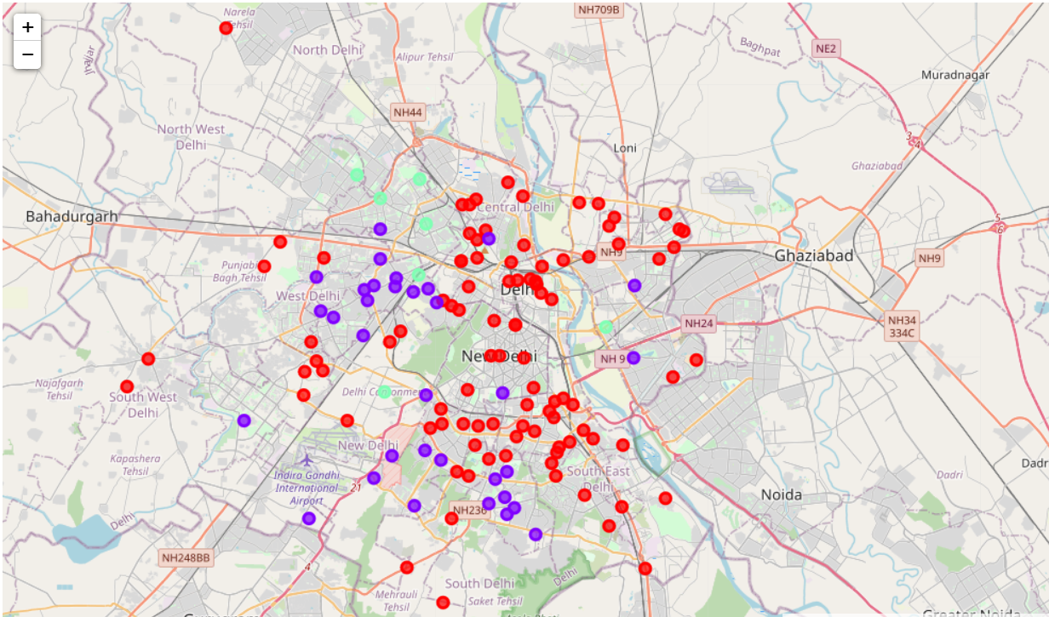
Result
Cluster 0 which is red mark in the map has very less number of shopping mall around 2.5 km of radius
Cluster 1 which is purple mark in the map has moderate number of shopping mall
Cluster 2 which is light green mark has higher number of shopping mall

Slide 6
discussion
As we can see that the cluster 2 has the higher number of shopping malls. Therefore they are suffering from intense competition,
In cluster 1 there is less number of shopping malls and therefore has less competition compare to cluster 2.
While in cluster 0 there is almost no shopping or very less shopping therefore it has almost no competition.

Slide 7
Recommendation
As we can see there is very high competition in cluster 2 neighbourhood hence it is recommended that there should not be opening of shopping mall in that neighbourhood
If you have skills of selling product better or having a unique product then cluster 1 neighbourhood is recommended.
Cluster 0 is highly recommended as there is almost no competition and people around these neighbourhood would not have to travel much for shopping mall.

Slide 8
Thank you

